Slide 1
CSE 221
Algorithms
Single Source Shortest Path
Bellman Ford Algorithm
DAG

Slide 2
Negative-Weight Edges
s → a: only one path
δ(s, a) = w(s, a) = 3
s → b: only one path
δ(s, b) = w(s, a) + w(a, b) = -1
s → c: infinitely many paths
⟨s, c⟩, ⟨s, c, d, c⟩, ⟨s, c, d, c, d, c⟩
cycle has positive weight (6 - 3 = 3)
⟨s, c⟩ is shortest path with weight δ(s, b) = w(s, c) = 5
What if we have negative-weight edges?
a
b
3
-4
-1
3
4
c
6
d
g
s
0
5
5
11
8
-∞
y
-3
2
3
7
-∞
-∞
e
-6
f

Slide 3
Negative-Weight Edges
s → e: infinitely many paths:
  ⟨s, e⟩, ⟨s, e, f, e⟩, ⟨s, e, f, e, f, e⟩
  cycle ⟨e, f, e⟩ has negative weight:
  3 + (- 6) = -3
  can find paths from s to e with arbitrarily large negative weights
  δ(s, e) = - ∞ ⇒ no shortest path exists between s and e
  Similarly: δ(s, f) = - ∞, δ(s, g) = - ∞
a
b
3
-4
-1
3
4
c
6
d
g
s
0
5
5
11
8
-∞
y
-3
2
3
7
-∞
-∞
e
-6
f
h
i
∞
2
∞
h, i, j not
reachable
from s
-8
3
∞
j
δ(s, h) = δ(s, i) = δ(s, j) = ∞

Slide 4
Negative-Weight Edges
Negative-weight edges may form negative-weight cycles
If such cycles are reachable from
the source: δ(s, v) is not properly
defined
  Keep going around the cycle, and get
  w(s, v) = - ∞ for all v on the cycle
a
b
-4
3
4
c
6
d
g
s
0
5
8
y
-3
2
3
7
e
-6
f

Slide 5
Cycles
Can shortest paths contain cycles?
Negative-weight cycles
Positive-weight cycles:
  By removing the cycle we can get a shorter path
We will assume that when we are finding shortest paths, the paths will have no cycles
No!
No!

Slide 6
Shortest-Path Representation
For each vertex v ∈ V:
d[v] = δ(s, v): a shortest-path estimate
  Initially, d[v]=∞
  Reduces as algorithms progress
π[v] = predecessor of v on a shortest path from s
  If no predecessor, π[v] = NIL
  π induces a tree—shortest-path tree
t
x
3
6
9
3
4
s
0
2
1
2
7
5
3
5
11
6
y
z

Slide 7
Initialization
Alg.: INITIALIZE-SINGLE-SOURCE(V, s)
for each v ∈ V
do d[v] ← ∞
π[v] ← NIL
d[s] ← 0
All the shortest-paths algorithms start with INITIALIZE-SINGLE-SOURCE

Slide 8
Relaxation
Relaxing an edge (u, v) = testing whether we can improve the shortest path to v found so far by going through u
  If d[v] > d[u] + w(u, v)
  we can improve the shortest path to v
  ⇒ update d[v] and π[v]
s
s
u
v
u
v
After relaxation:
  d[v] ≤ d[u] + w(u, v)
5
2
9
5
2
6
RELAX(u, v, w)
RELAX(u, v, w)
u
v
u
v
5
2
7
5
2
6

Slide 9
RELAX(u, v, w)
if d[v] > d[u] + w(u, v)
then d[v] ← d[u] + w(u, v)
π[v] ← u
All the single-source shortest-paths algorithms
  start by calling INIT-SINGLE-SOURCE
  then relax edges
The algorithms differ in the order and how many times they relax each edge

Slide 10
Bellman-Ford Algorithm
Single-source shortest paths problem
  Computes d[v] and π[v] for all v ∈ V
Allows negative edge weights
Returns:
  TRUE if no negative-weight cycles are reachable from the source s
  FALSE otherwise ⇒ no solution exists
Idea:
  Traverse all the edges |V – 1| times, every time performing a relaxation step of each edge

Slide 11
BELLMAN-FORD(V, E, w, s)
INITIALIZE-SINGLE-SOURCE(V, s)
for i ← 1 to |V| - 1
do for each edge (u, v) ∈ E
do RELAX(u, v, w)
for each edge (u, v) ∈ E
do if d[v] > d[u] + w(u, v)
then return FALSE
return TRUE
E: (t, x), (t, y), (t, z), (x, t), (y, x), (y, z), (z, x), (z, s), (s, t), (s, y)

Slide 12
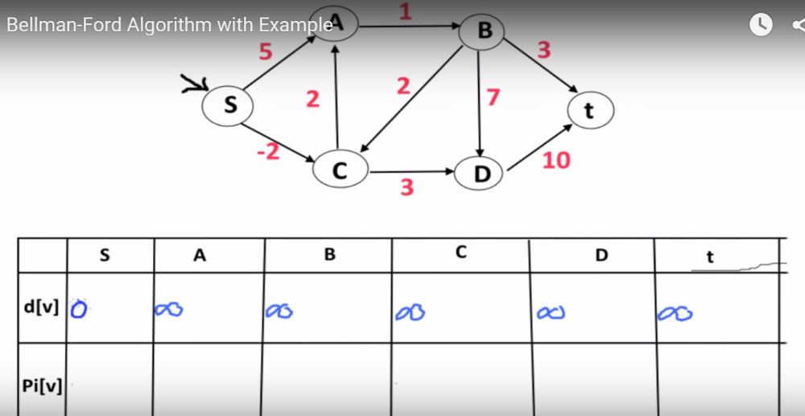

Slide 13
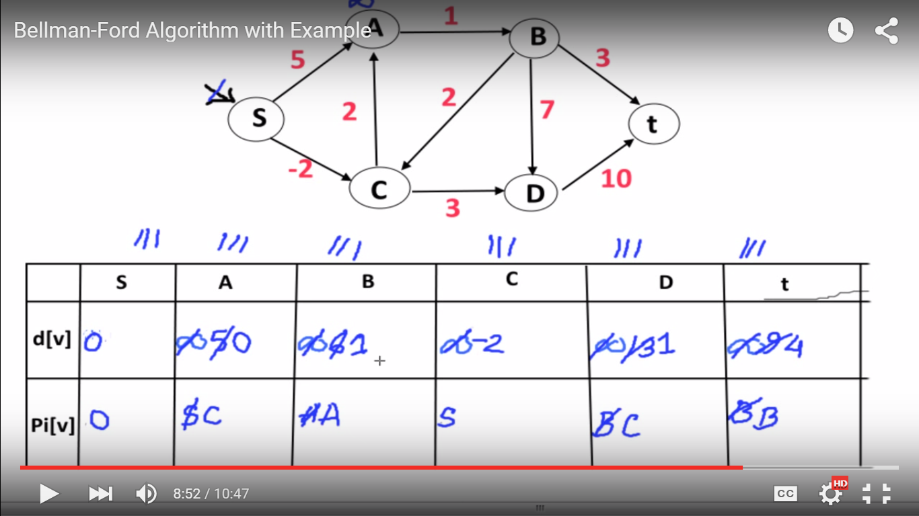

Slide 14
BELLMAN-FORD(V, E, w, s)
INITIALIZE-SINGLE-SOURCE(V, s)
for i ← 1 to |V| - 1
do for each edge (u, v) ∈ E
do RELAX(u, v, w)
for each edge (u, v) ∈ E
do if d[v] > d[u] + w(u, v)
then return FALSE
return TRUE
Running time: O(VE)
Θ(V)
O(V)
O(E)
O(VE)
O(E)

